Slide 1

CT4009 Introduction to Web Development
Semester 1 Week 2
HTML – List, Links, Images, Tables, Forms, Video

Slide 2
Agenda
Review – Last week lab and home work
A journey of a web site
HTML – List, Links, Images, Tables, Forms, Video
This week Lab and home work

Slide 3
Review – Last week lab and home work
Have you
completed worksheet (CT4009_labwork_sem1_wk1.pdf) ?
sketched the layout of the web pages required for assignment 1?
created the folders/sub-folders for assignment1 web pages?
created mock html pages (containing text description of their purpose and contents) required for assignment1?

Slide 4
Other similar websites
1. Find that bike
http://www.findthatbike.co.uk/
is a site for UK citizens to find stolen bikes. Simply browse through the ads and see if you recognise your bike
2. Stolen 911
http://stolen911.com/
Create a free Internet Fingerprint of your stolen property
3. Hertsreunited
https://www.herts.police.uk/hertfordshire_constabulary/hertsreunited.aspx
A website, HertsReunited, to help reunite members of the public with their lost and stolen property, was launched in January 2015 by the Police and Crime Commissioner for Hertfordshire and Hertfordshire Constabulary.

Slide 5
Other similar websites (continued)
4. leads online
www.leadsonline.com
http://technical.ly/philly/2015/01/14/leadsonline-pawn-shops-police/ -article
Run by a Dallas, Texas-based company, LeadsOnline is an online database that officers in the Philadelphia Police Department, like Panebianco, use to nab burglars and recover stolen items.
5. Immobilise (The UK National Property Register)
www.immobilise.com
Immobilise is the world's largest FREE register of possession ownership details
6. CheckMend
http://www.checkmend.com/
The world's largest database of over 150 billion records of property providing relevant information to purchasers of used goods.

Slide 6
Other similar websites (continued)
7. 529 Garage
https://project529.com/garage/
Here at Project 529 we aim to put the brakes on the stolen bike market through an innovative registration and recovery service called the 529 Garage.
8. Bike Register
https://www.bikeregister.com
Register your bike. Add your bike details to our National Police-approved database for free.

Slide 7




A journey of a website
Programming languages, database
Frameworks
Development tools, FTP software
Webserver
HTTP – request and response

Slide 8
Development – Programming Languages and Database
Client-side languages
JavaScript
HTML
CSS
Server-side languages
JavaScript (e.g. Node.js)
Java
Python
PHP
Ruby
C#
Objective C
Swift
ASP.net
Database
Oracle
SQL Server
MySQL
DB2
PostgreSQL
MongoDB
Cassandra

Slide 9
Choosing a Programming Language
Java
Java is not related to JavaScript in any meaningful way.
Can be used for web applications to desktop and mobile apps.
Dominating the area of enterprise applications (e.g. bank, hospital, university software)
Powers Android apps
Objective-C
can be used to write desktop software and mobile apps
Objective-C is essentially Apple territory
Until the recent release of the Swift programming language, Objective-C was the language for developing native iPhone and iPad apps.
it’s a good idea to learn Objective-C, if you want to work on iPhone and iPad apps.

Slide 10
Choosing a Programming Language (continued)
Swift
Released Swift in June, 2014
For developing Mac, iPad, iPhone, Apple Watch, and Apple TV applications.
you’ll need some understanding of both Objective-C and Swift, if you want to enter the world of iOS
PHP
PHP is one of the most popular web languages.
Facebook, Etsy, WordPress and Drupal were implemented using PHP.

Slide 11
Choosing a Programming Language (continued)
Python
Python is a general-purpose language used for everything from server automation to data science.
easy to read and understand.
Instagram was implemented in Python.
Ruby
Ruby is often associated with the Rails framework that helped popularize it.
Ruby and Rails make it easy to transform an idea into a working application.
Twitter, GitHub, and Treehouse were implemented in Ruby.

Slide 12
Choosing a Database
Relational Database (Oracle, MySQL, SQL Server etc)
Remove redundancy
Improve data integrity
NoSQL (MongoDB, Cassandra etc)
Scalable database
Big Data (VVV)

Slide 13
Frameworks
UI frameworks
Foundation
Sencha Touch
Onsen UI
Ionic
Bootstrap
HTML KickStart
Framework 7
Javascript frameworks
Angular2
ReactJS
VUE.js
Ember.js
Meteor.js
PHP frameworks
Laravel
Symfony
CodeIgniter
Yii 2
Phalcon
CakePHP
Zend
FuelPHP
Efficiency — projects can be achieved much faster with well-structured prebuilt patterns and functions.
Safety — frameworks have firm security arrangements and are supported by large communities where members and users also act as testers.
Cost — most frameworks are open source and free. Since they help programmers to build custom solutions faster, the ultimate price for web app will be lower.
Also, to create responsive web site and for code maintenance.
No recommended until you have learnt basic syntax.

Slide 14
Development Tool
Browsers Built in tools
Chrome DevTools
Firefox Developer Tools
Editors
Sublime Text
Notepad ++
Atom
Brackets
Visual Studio Code
Dreamweaver
NetBeans
Eclipse
For
Code highlighting
Compiling
Debugging
GUI builder
Smart autocompletion
Code management
Live Preview

Slide 15
File Transfer Protocol (FTP) Software
FileZilla
Cyberduck
Free FTP
FireFTP
FOFF
WinSCP
AndFTP

Slide 16


Webserver (HTTP Server + Programming Language Run-time + Database Server)
HTTP Server
Apache
NGINX
IIS
LiteSpeed
Try
Apache
PHP Pre-processor
MySQL
Server

Slide 17




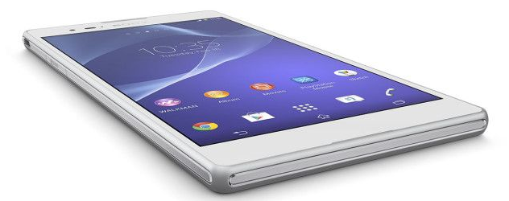
Publish website
Register Domain Names in DNS Server
Host Website in Web Server
HTTP Request
Static IP Address
HTTP Response
Client
Dynamic IP Address

Slide 18
Hypertext Transfer Protocol (HTTP)
Can deliver any data - Images/videos/Audios/Hypertext/Text
Connectionless Protocol / Persistent connection
HTTP is a stateless protocol. A stateless protocol does not require the HTTP server to retain information or status about each user for the duration of multiple requests.

Slide 19
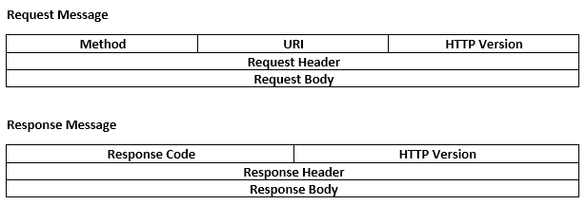
HTTP Messages

Slide 20
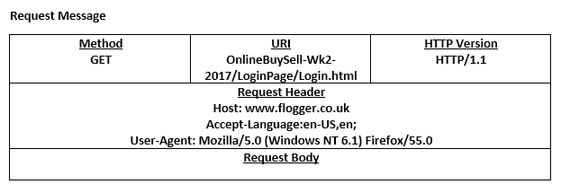
An example of the HTTP request message
http://www.flogger.co.uk/OnlineBuySell-Wk2-2017/LoginPage/Login.html

Slide 21
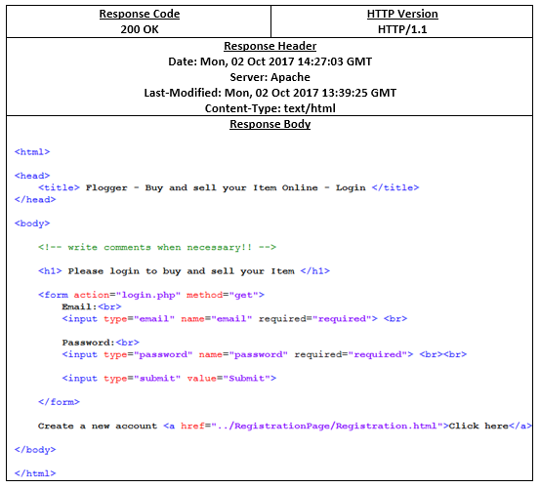
An example of the HTTP response message
http://www.flogger.co.uk/OnlineBuySell-Wk2-2017/LoginPage/Login.html

Slide 22
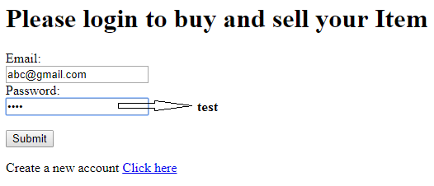
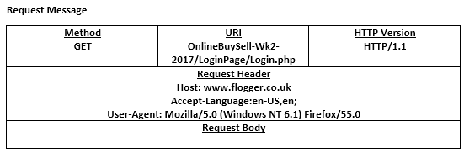
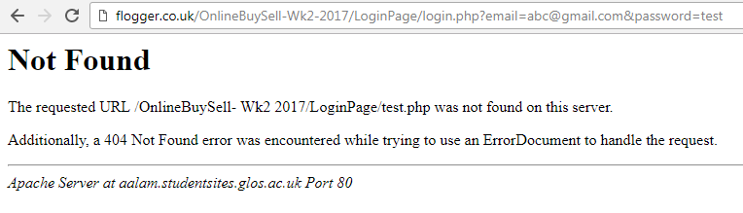
Another example of the HTTP request message – Get Method
http://www.flogger.co.uk/OnlineBuySell-Wk2-2017/LoginPage/Login.php
Hidden text field values appear in the url/address bar

Slide 23
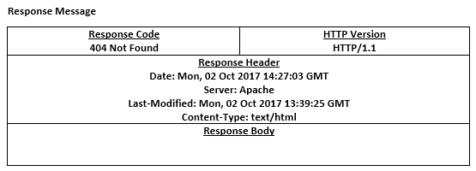
Hence response message
http://www.flogger.co.uk/OnlineBuySell-Wk2-2017/LoginPage/Login.php

Slide 24
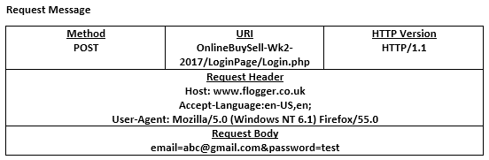
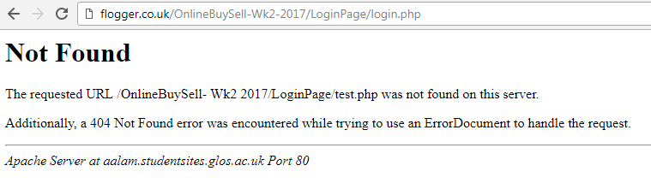
Another example of the HTTP request message – Post Method
http://www.flogger.co.uk/OnlineBuySell-Wk2-2017/LoginPage/Login.php

Slide 25
Get VS Post
GET requests can be cached
GET requests remain in the browser history
GET requests can be bookmarked
GET requests should never be used when dealing with sensitive data
GET requests have length restrictions
GET requests should be used only to retrieve data
POST requests are never cached
POST requests do not remain in the browser history
POST requests cannot be bookmarked
POST requests have no restrictions on data length

Slide 26
Secure Hypertext Transfer Protocol (HTTPS)
Purchase SSL Certificate
Configure and install the certificate in web server

Slide 27
HTML – List, Links, Images, Table, Forms, Video

Slide 28
HTML Tag/Element Syntax
Example: Input Opening Tag

Slide 29
Relative link types (pg 84 Duckett)
SAME FOLDER <a href=“reviews.html”>Reviews</a>
CHILD FOLDER <a href=“music/listings.html”>Listings</a>
GRANDCHILD FOLDER <a href=“/movies/dvd/reviews.html”>
Reviews</a>
PARENT FOLDER <a href=“../index.html”>Home</a>
GRANDPARENT <a href=“../../index.html”Home</a>

Slide 30
What do these do?...
<a href=“http://www.imdb.com” target=“_blank”>Internet Movie Database</a>
<a href=“mailto:bmcqueer@glos.ac.uk” Send to Billy</a>
<a href=“#top”>Top</a>

Slide 31
Linking within Pages…
<!-- A sample menu -->
<h1 id=“top”>Menu</h1>
<a href=“#item_1”>Item 1</a><br />
<a href=“#item_2”>Item 2</a><br />
<a href=“#item_3”>Item 3</a><br />
<h2 id=“item_1”>Item 1</h2>
<p> This is a description of item 1, I just can’t believe how easy HTML is!</p>
…
<p><a href=“#top”>Return to top</a></p>
Set id
Set id
Call id

Slide 32
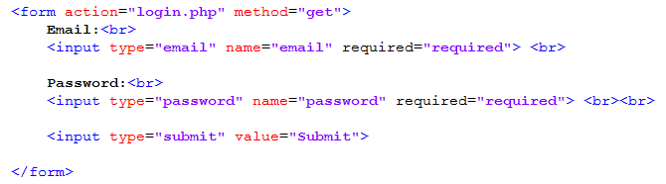
HTML Form and Input Tag
Form Tag
The HTML <form> tag is used for creating a form for user input.
A form can contain textfields, checkboxes, radio-buttons and more.
Forms are used to pass user-data to a specified URL.
Input Tag
The <input> tag specifies an input field where the user can enter data.

Slide 33
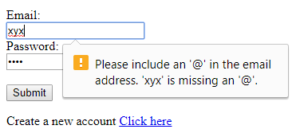
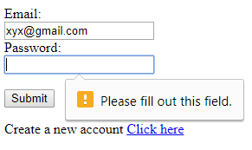
Type and required attribute

Slide 34
Name and ID attribute
The name attribute on an input is used by its parent HTML <form> to include that element as a member of the HTTP form in a POST request or the query string in a GET request.
The id should be unique as it should be used by JavaScript to select the element in the DOM for manipulation and used in CSS selectors.

Slide 35
Name attribute

Slide 36

HTML textarea Tag

Slide 37
HTML input - type file

Slide 38


HTML input - type submit
defines a button for submitting the form data to a form-handler.

Slide 39
HTML Lists
<ol>
<li> First </li>
<li> Second </li>
<li> Third </li>
</ol>
First
Second
Third
<ul>
<li> First </li>
<li> Second </li>
<li> Third </li>
</ul>
First
Second
Third

Slide 40

HTML ordered list

Slide 41
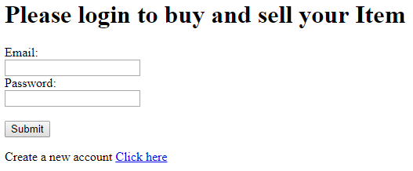
HTML a tag and href attribute
A relative path is a way to specify the location of a directory relative to another directory.

Slide 42
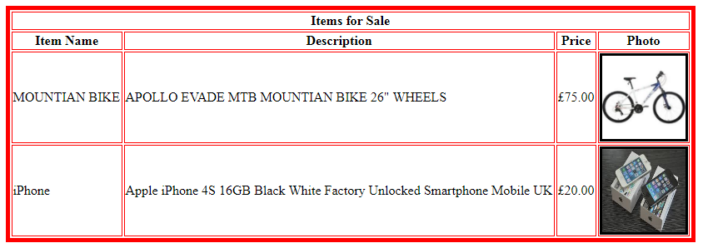
HTML <table> tag - to define a table
<th> | Defines a header cell in a table
<tr> | Defines a row in a table
<td> | Defines a cell in a table

Slide 43
HTML Tables
<table>
<tr> <!-- ROW 1 -- >
<th></th>
<th>Red Team</th>
<th>Blue Team</th>
<th>Yellow Team</th>
</tr>
<tr> <!-- ROW 2 -- >
<th>Name</th>
<td> Peter</td>
<td>Tom </td>
<td>Sally </td>
</tr>
<tr><!-- ROW 3 -- >
<th>Score</th>
<! -- WHAT COMES NEXT ?-- >
</table>
 | Red Team | Blue Team | Yellow Team
Name | Peter | Tom | Sally
Score | 50 | 45 | 60
What is colspan and rowspan?
 | Red Team | Blue Team | Yellow Team
Name | Peter | Tom | Sally
Score | 50 |  | 60
<td colspan =“2”>50</td>

Slide 44

Include youtube video
Use the youtube site to find the video you want
Click the 'Share' button below the video
Click the 'Embed' button next to the link they show you
Copy the iframe code given and paste it into the html of your web page.

Slide 45
Lab work
Update the following pages as instructed in the worksheet (CT4009_labwork_sem1_wk2.pdf) given in the moodle :
Page 1 : Login Page
Page 2 : Registration Page
Page 3 : Sell Item Page
Page 4 : List my items for sale Page (manage my items)
Page 5 : List all items for sale Page
Page 6 : Buy an Item Page
Tips
Type “closing tag” immediately after you typed “opening tag”, then type the “contents” in between
Always check how the web page look like after adding some contents, don’t wait until you finish adding all contents

Slide 46
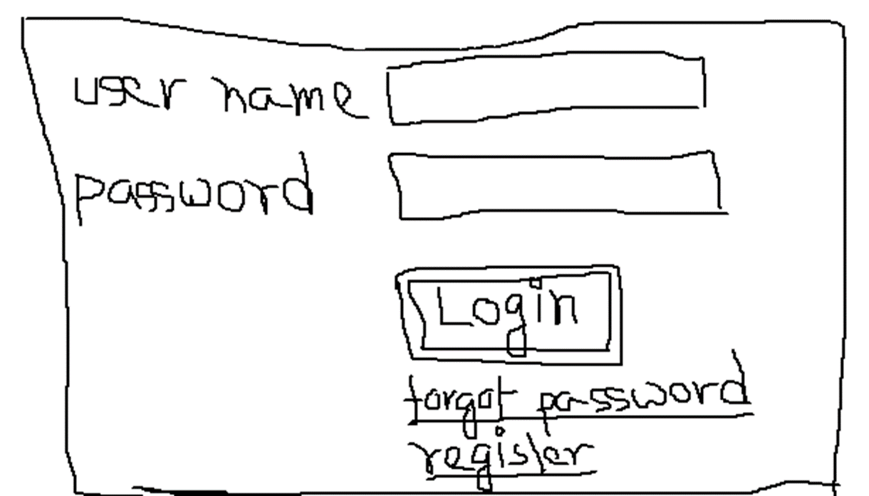
Home Work
Include the necessary contents/elements in the html pages required for assignment1 based on the last week home work drawings.

